Slide 1







Autonomous AI DBA Operations Platform
AI-Powered Database Reliability & Incident Automation System
Presented By: Shami Gaffar
CORE TECHNOLOGY STACK

Slide 2



Project Definition
What is the Project?
The Autonomous AI DBA Operations Platform is an AI-assisted operational intelligence platform designed to revolutionize SQL Server database administration.
It seamlessly integrates advanced monitoring, machine learning, and automation to achieve peak database reliability.
Core Capabilities:
→
Intelligent monitoring
→
AI-driven Root Cause Analysis (RCA)
→
Performance diagnostics & automation workflows
→
Governance and operational reporting

Slide 3


Business Problem Statement
DBA Challenges
Technical Challenges
→
Manual monitoring and troubleshooting
→
Blocking sessions and deadlocks
→
Delayed incident response times
→
High CPU and memory usage
→
Repetitive operational activities
→
Backup failures and data risks
→
Slow Root Cause Analysis (RCA)
→
Long-running inefficient queries
→
Reactive operational workflows
→
Unpredictable database growth issues
Business Impact:
• Increased downtime • SLA violations • Reduced productivity • Higher operational cost

Slide 4
Project Objectives
Automate Monitoring: Streamline SQL Server operational tracking and metric collection.
AI-Powered RCA: Automatically generate comprehensive Root Cause Analysis reports.
Intelligent Remediation: Provide actionable, context-aware remediation recommendations.
Database Observability: Dramatically improve overall system visibility and health tracking.
Reduce MTTR: Significantly lower the Mean Time to Resolution for critical incidents.
Enhance Governance: Improve operational auditability and compliance standards.
Proactive Operations: Shift DBA workflows from reactive firefighting to proactive management.

Slide 5


Why AI-Assisted?
Traditional Monitoring
AI-Assisted Approach
→
Generate isolated alerts only
→
Context-aware, holistic analysis of system state
→
Require extensive manual analysis
→
AI-generated Root Cause Analysis immediately available
→
Highly reactive troubleshooting methodology
→
Intelligent, specific remediation recommendations
→
Limited operational intelligence and context
→
Deep operational insights mapping symptoms to causes
→
Slow resolution times leading to prolonged impact
→
Automated workflow orchestration for rapid resolution

Slide 6







High-Level Architecture
Data Collection
AI Processing
Analysis & Action
Execution & Audit
SQL Server / Azure SQL
MCP Server Hub
RCA Engine
Automation Engine
Monitoring Collectors
AI DB Agent
Recommendation Engine
Email/Teams Alerts
Azure Log Analytics
OpenRouter / OpenAI
Approval Workflow
Audit Logging

Slide 7









Core Platform Components
Monitoring Engine
AI DB Agent
Governance Layer
•
CPU & Memory tracking
•
AI RCA generation
•
Secure approval workflows
•
Blocking detection
•
Deep incident analysis
•
Comprehensive audit logging
•
Backup status monitoring
•
Query tuning suggestions
•
Controlled script execution
•
Query performance tracking
•
Performance diagnostics
•
Pre-execution risk validation

Slide 8

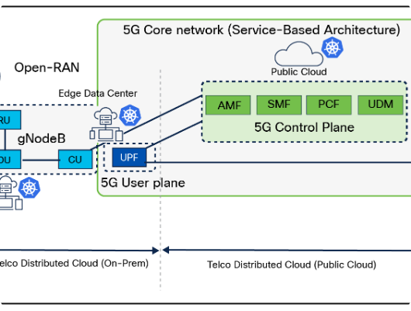
MCP Server Layer
The Model Context Protocol (MCP) Server acts as the vital orchestration and communication layer between intelligent AI services and internal operational tools.
Core Responsibilities
→
Tool orchestration and routing
→
Complex workflow integration
→
Secure AI-to-system communication
→
Context handling for operational state
Architectural Benefits
→
Highly scalable, decoupled architecture
→
Structured, reproducible workflows
→
Modular AI model integration (agnostic)

Slide 9


Monitoring & Observability
Infrastructure Monitoring
Database Monitoring
Core hardware and operating system metrics ensuring platform stability.
SQL Server specific metrics to guarantee query performance and data integrity.
→
CPU utilization spikes and trends
→
Blocking sessions and isolation
→
Memory utilization and page life expectancy
→
Deadlock occurrence tracking
→
Disk latency and IOPS throughput
→
Long-running queries and resource hogs
→
TempDB file size and contention monitoring
→
Failed SQL Agent jobs
→
Backup status and Database growth

Slide 10







AI DB Agent Workflow
1. Detection
2. Analysis
3. Diagnostics
4. Action
Incident Detected: The monitoring engine identifies an anomaly or threshold breach.
AI Analysis: Context is passed to the LLM via the MCP server.
Root Cause Analysis: AI synthesizes findings into a human-readable RCA report.
Risk Classification: Proposed changes are scored for operational risk.
Pattern Recognition: Historical data and known SQL patterns are evaluated.
Recommendations: Specific T-SQL or config changes are generated.
Reporting: Final operational report is sent for DBA review and approval.
Data Collected: High-resolution telemetry and context are captured instantly.

Slide 11







AI-Powered RCA & Recommendations
Root Cause Analysis
Query Tuning
Operational Intelligence
•
Precise incident diagnosis
•
Missing index recommendations
•
Correlated symptom analysis
•
Execution plan optimization
•
Automated risk classification
•
Historical pattern identification
•
Statistics update suggestions
•
Dynamic incident prioritization
•
Log and evidence summarization
•
Bottleneck performance analysis
•
Long-term trend analysis
•
Capacity planning indicators

Slide 12


Governance & Security
Governance Controls
Security Features
Human-in-the-Loop Execution: High-risk operations require explicit DBA approval before automated execution.
→
Audit Logging: Immutable tracking of every recommendation, approval, and execution.
→
Approval Workflows: Multi-tier authorization integrated with ITSM tools.
Restricted Operations (Blocked):
→
Role-Based Validation: Ensuring only authorized personnel can approve specific database levels.
→
Controlled Execution: Sandboxed remediation script application.

Slide 13
Automation Features
Automated Service Recovery: Safely attempt to restart failed SQL Server Agent jobs based on predefined rules.
Health Reporting: Automatically generate and distribute comprehensive DBA health reports to stakeholders.
Smart Alerting: Trigger automated, context-rich alert notifications via Teams or Email.
Daily Operations: Compile and deliver daily operational roll-ups for morning DBA reviews.
Monitoring Snapshots: Capture deep-dive telemetry snapshots exactly when an incident occurs.
ITSM Integration: Seamless incident logging automation (e.g., Jira, ServiceNow) with AI notes appended.

Slide 14



Technology Stack
Backend & AI
Data & Monitoring
Tools & Automation
•
Language: Python
•
DB: Microsoft SQL Server, Azure SQL
•
Orchestration: Azure Automation
•
Framework: FastAPI
•
Drivers: pymssql, pyodbc
•
Editor: VS Code
•
AI Integration: OpenRouter API
•
Monitoring: Azure Monitor
•
VCS: Git
•
Models: OpenAI GPT series
•
Logs: Log Analytics
•
Platform: GitHub

Slide 15


Current Development Status
Completed Work
Currently In Progress
→
Project structure setup & initialization
→
Developing distinct monitoring collectors
→
Git repository established
→
Writing & optimizing SQL monitoring queries
→
Python virtual environment and dependencies
→
Active MCP Server implementation
→
Comprehensive architecture planning
→
Designing initial reporting workflows
→
MCP architecture definition
→
Establishing connection pooling mechanisms
→
AI DB Agent foundational logic
→
OpenRouter AI integration testing
→
Monitoring framework structure designed

Slide 16

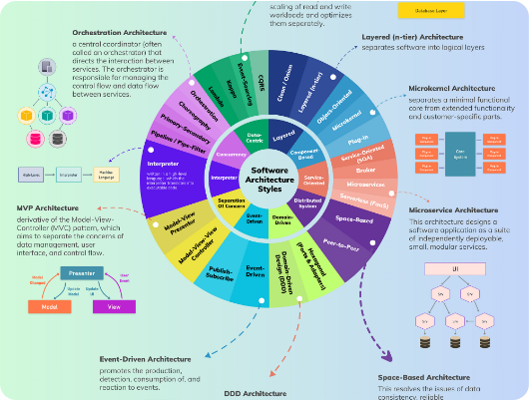
Engineering Approach
The project strictly follows a modular and scalable architecture to support future enhancements and integrate seamlessly into enterprise-level operational workflows.
Core Design Principles
→
Modular, decoupled architecture
→
Highly readable and documented code
→
Governance-oriented workflows built-in
→
AI-assisted operational intelligence
→
Controlled, secure automation boundaries

Slide 17





Business Benefits
Operational
Technical
Business
•
Much faster incident response
•
AI-assisted troubleshooting
•
Reduced overall downtime
•
Reduced manual DBA workload
•
Vastly better observability
•
Better SLA compliance
•
Standardized operational flows
•
Centralized operational intel
•
Improved engineering productivity
•
Improved monitoring visibility
•
Improved database reliability
•
Reduced operational overhead

Slide 18








Project Roadmap
Foundation
AI & Monitoring
Governance
Optimization
•
Project documentation
•
AI DB Agent implementation
•
Human-in-loop approvals
•
Predictive analytics models
•
Architecture finalization
•
Audit logging mechanism
•
Monitoring framework setup
•
OpenRouter/OpenAI linking
•
Smart alerting system
•
Power BI dashboards
•
Automated reporting gen
•
ServiceNow/Jira integration
•
MCP architecture planning
•
Monitoring collectors build
•
Advanced anomaly detection
•
Incident analysis workflows

Slide 19

Future Enhancements
Looking beyond the core implementation, the platform is designed to evolve into a fully autonomous system.
Autonomous, zero-touch remediation
Predictive operational analytics
Multi-database platform support (PostgreSQL/Oracle)
Deep Kubernetes integration
Live Power BI dashboards
AI-powered anomaly prediction

Slide 20
Conclusion
The Autonomous AI DBA Operations Platform is designed as an enterprise-focused, AI-assisted operational intelligence system for SQL Server reliability engineering.
By combining AI-powered analysis, intelligent monitoring, strict governance workflows, and centralized reporting, it dramatically improves database reliability, boosts operational efficiency, and enables proactive incident management at scale.

Slide 21

Questions?
Thank you for your time and attention.
Autonomous AI DBA Operations Platform
AI-Powered Database Reliability & Incident Automation System
Shami Gaffar

Slide 22




Image Sources
https://img.freepik.com/premium-photo/abstract-depiction-artificial-intelligence-with-human-head-composed-data-circuits-glowing-blue-background_670147-111613.jpg
Source: www.freepik.com
https://www.cisco.com/c/dam/en/us/solutions/collateral/service-provider/data-center/nw-infra-telco-edge-dc-wp.docx/_jcr_content/renditions/nw-infra-telco-edge-dc-wp_0.png
Source: www.cisco.com
https://miro.medium.com/v2/resize:fit:2000/1*46JX-o6xxMaMmOmTLwyLYQ.png
Source: medium.com
https://static.vecteezy.com/system/resources/previews/075/996/116/large_2x/woman-hands-and-3d-hologram-of-dashboard-in-digital-transformation-analytics-or-data-research-female-employee-busy-on-futuristic-technology-ui-or-holographic-display-for-analysis-or-statistics-photo.jpg
Source: www.vecteezy.com

